Slide 1
List and Iterators
Reading: Chapter 7
Data Structures and Algorithms in Java

Slide 2
ArrayList methods (review)
add(value) | appends value at end of list
add(index, value) | inserts given value just before the given index, shifting subsequent values to the right
clear() | removes all elements of the list
indexOf(value) | returns first index where given value is found in list (-1 if not found)
get(index) | returns the value at given index
remove(index) | removes/returns value at given index, shifting subsequent values to the left
set(index, value) | replaces value at given index with given value
size() | returns the number of elements in list
toString() | returns a string representation of the list such as "[3, 42, -7, 15]"
contains(value) | returns true if given value is found somewhere in this list
lastIndexOf(value) | returns last index value is found in list (-1 if not found)
ArrayList<String> names = new ArrayList<String>();

Slide 3
LinkedList methods (review)
A LinkedList can be used much like an ArrayList (both implement the List interface).
We can add, change, remove items and clear the list in the same way
LinkedList <String> words = new LinkedList<String>();
words.add("hello");
words.add("goodbye");
words.add("this");
words.add("that");
LinkedList provides several more efficient methods
addFirst() | Adds an item to the beginning of the list.
addLast() | Add an item to the end of the list
removeFirst() | Remove an item from the beginning of the list.
removeLast() | Remove an item from the end of the list
getFirst() | Get the item at the beginning of the list
getLast() | Get the item at the end of the list
addFirst() | Adds an item to the beginning of the list.

Slide 4
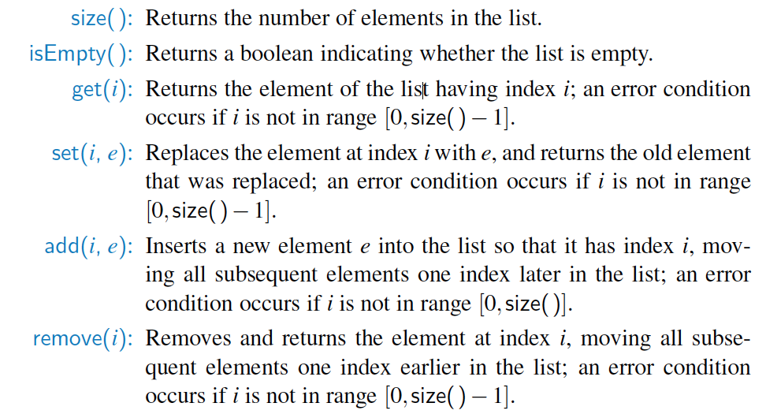
java.util.List interface
Includes the several index-based methods (and more):

Slide 5
Insertion
In an operation add(i, o), we need to make room for the new element by shifting forward the n - i elements A[i], …, A[n - 1]
A
In the worst case (i = 0), this takes O(n) time
When the array is full, we replace the array with a larger one
0
1
2
i
n
A
0
1
2
i
n
A
o
0
1
2
i
n
reassign reference A to the new array.
create new array B;
store elements of A in B;

Slide 6
The Arrays class (review)
Class Arrays in java.util has many useful array methods:
Syntax: Arrays.methodName(parameters)
Method name | Description
binarySearch(array, value) | returns the index of the given value in a sorted array (or < 0 if not found)
binarySearch(array, minIndex, maxIndex, value) | returns index of given value in a sorted array between indexes min /max - 1 (< 0 if not found)
copyOf(array, length) | returns a new resized copy of an array
equals(array1, array2) | returns true if the two arrays contain same elements in the same order
fill(array, value) | sets every element to the given value
sort(array) | arranges the elements into sorted order
toString(array) | returns a string representing the array, such as "[10, 30, -25, 17]"

Slide 7
Element Removal
In an operation remove(i), we need to fill the hole left by the removed element by shifting backward the n - i - 1 elements A[i + 1], …, A[n - 1]
In the worst case (i = 0), this takes O(n) time
A
o
0
1
2
i
n
A
0
1
2
i
n
A
0
1
2
i
n

Slide 8
Our Generic ArrayList
import java.util.*;
public class ArrayList<E> {
protected static final int INITIAL_CAPACITY = 10;
private int size;
private E[] elementData;
public ArrayList() {this(INITIAL_CAPACITY); }
public ArrayList(int capacity) {
if (capacity <= 0) {
throw new IllegalArgumentException("capacity must be
positive: " + capacity);
}
elementData = (E[ ]) new Object[capacity];
}
public int get(int index) {
checkIndex(index, size - 1);
return elementData[index];
}
public void set(int index, E obj) {
checkIndex(index, size - 1);
elementData[index] = obj;
}

Slide 9
Our Generic ArrayList
public void add(int index, E obj) {
checkIndex(index, size);
checkResize();
for (int i = size; i > index; i--) {
elementData[i] = elementData[i - 1];
}
elementData[index] = obj;
size++;
}
public void add(E obj) { add(size, obj); }
public void remove(int index) {
checkIndex(index, size - 1);
for (int i = index; i <= size - 1; i++) {
elementData[i] = elementData[i + 1];
}
elementData[size -1] = null;
size--;
}
public int size() { return size; }
public boolean isEmpty() { return size == 0; }

Slide 10
Our Generic ArrayList
public int indexOf(E value) {
for (int i = 0; i < size; i++) {
if (elementData[i].equals(value)){
return i;
}
return -1; // not found
}
public boolean contains(E value) { return indexOf(value) >= 0;}
private void checkResize() {
if (size == elementData.length)
elementData = Arrays.copyOf(elementData, 2 * size);
}
private void checkIndex(int index, int max) {
if (index < 0 || index > max) {
throw new ArrayIndexOutOfBoundsException();
}
}

Slide 11
Our Generic ArrayList
public String toString() {
if (size > 0) {
String result = "[" + elementData[0];
for (int i = 1; i < size; i++)
result = result + ", " + elementData[i];
result += "]";
return result;
} else
return "[]"; // empty list
}
}

Slide 12
Iterator
An iterator is a software design pattern that abstracts the process of scanning through a sequence of elements, one element at a time.
Iterator interface in java.util
Java defines a parameterized interface, named Iterable, that includes the following single method:
iterator( ): Returns an iterator of the elements in the collection.
Instances of most typical collection classes such as an ArrayList, are iterable; they produce an iterator for the collection as the return value of the iterator( ) method.
List<String> list = new ArrayList<String>();
...
Iterator<String> itr = list.iterator();
...

Slide 13
Iterator
Each call to iterator( ) returns a new iterator instance, thereby allowing multiple (even simultaneous) traversals of a collection.
hasNext() | returns true if there are more elements to examine
next() | returns the next element from the collection (throws a NoSuchElementException if there are none left to examine)
remove() | removes the last value returned by next() (throws an IllegalStateException if you haven't called next() yet)
public static void main(String[] args) {
ArrayList<Integer> numbers = new ArrayList<Integer>();
numbers.add(12); numbers.add(8);
numbers.add(2); numbers.add(23);
Iterator<Integer> it = numbers.iterator();
while(it.hasNext()) {
Integer i = it.next();
if(i < 10) it.remove();
}
System.out.println(numbers);
}

Slide 14
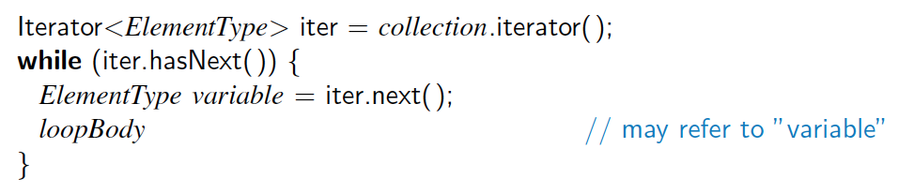
The "for each" loop
Java’s Iterable class also plays a fundamental role in support of the “for-each” loop syntax:
for (type name : collection) {
statements;
}
Provides a clean syntax for looping over the elements of a Set, List, array, or other collection
needed because some collections like sets have no indexes; can't get element i
List<Double> grades = new ArrayLisy<Double>();
//adding some elements
for (double grade : grades) {
System.out.println("Student's grade: " + grade);
}
is equivalent to:

Slide 15
Iterators and linked lists
List<Integer> list = new LinkedList<Integer>();
// add some elements
for (int i = 0; i < list.size(); i++) {
System.out.println(list.get(i));
}
What's bad about this code?
This code is O(N²) because each call on get must start from the beginning of the list and walk to index i.
Using an iterator, the same code is O(N). The iterator remembers its position and doesn't start over each time.
front =
data | next
42
data | next
-3
data | next
17
element 0
element 1
element 2
Iterator<Integer> it = list.iterator();
while(it.hasNext()) {
System.out.println(it.next());
}
current element: -3
current index: 1
iterator

